Slide 1

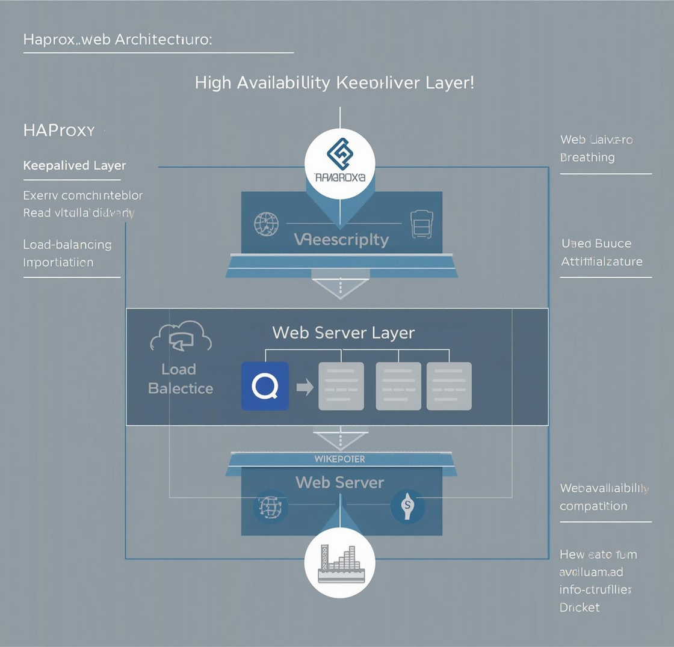
Building a Robust and Scalable Web System: Failover and High Availability
Discover methods to construct an efficient system that is scalable and minimizes the risk of operational downtime.

Slide 2

Downtime Risk and Load Spikes
Understanding the challenges of web system reliability
Downtime poses a significant risk to web systems, especially during load spikes. A single server failure can lead to slow response times and ultimately impact user experience, highlighting the need for a robust solution to ensure continuous availability.

Slide 3
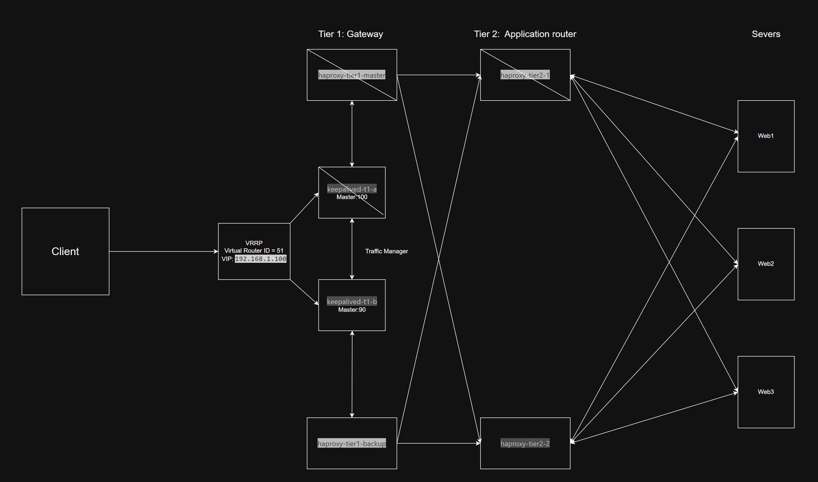
Architecture Overview
An overview of how the 3-tier architecture integrates Docker for seamless deployment and management.
3-Tier Architecture
This diagram showcases the 3-tier architecture, emphasizing the separation of concerns and efficient communication between tiers.
Load Balancer Setup
This diagram illustrates the load balancer's role in distributing traffic effectively among web servers, enhancing system resilience and performance.

Slide 4
Tier 1 Goals: Enhancing Web Resilience
Eliminate Single Point
HAProxy and Keepalived ensure no single failure disrupts service.
Implement VRRP
Virtual Router Redundancy Protocol manages active instances efficiently.
Health Monitoring
Continuous health checks guarantee prompt failover and system reliability.
Simplified Management
Using Docker optimizes deployment and reduces configuration overhead.

Slide 5
VRRP Concept Overview
Understanding VRRP Architecture
VRRP (Virtual Router Redundancy Protocol) enables a highly available system by allowing a MASTER and BACKUP to manage a shared Virtual IP (VIP) effectively.
MASTER and BACKUP Roles
The MASTER node handles traffic while the BACKUP remains on standby, ready to take over in case of a failure, ensuring continuous service availability.
Key Features of VRRP
Election process determines MASTER based on priority.
VIP 192.168.100.100 is assigned to MASTER.
BACKUP activates immediately upon MASTER failure.

Slide 6
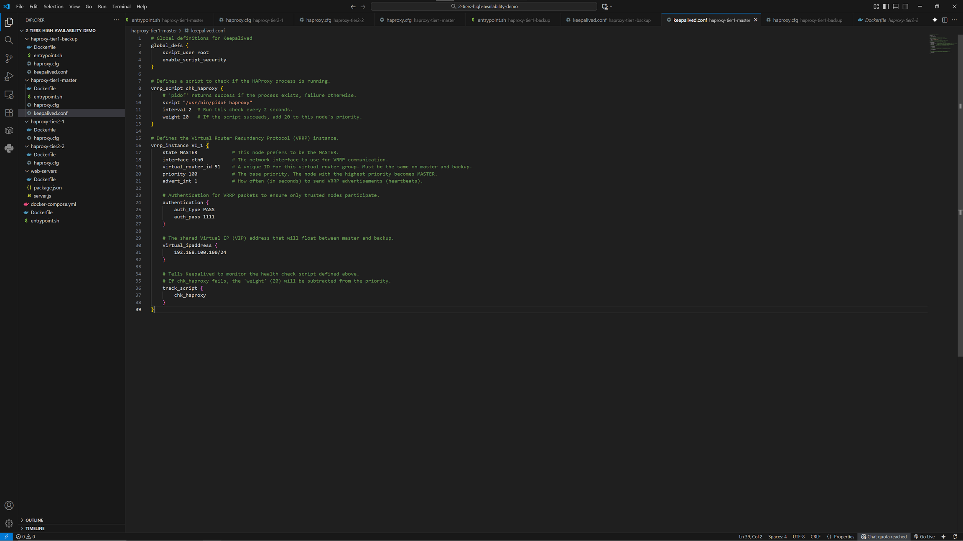
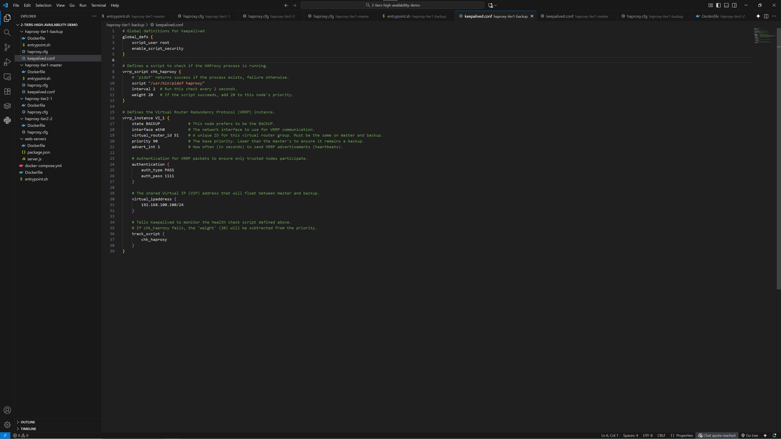
keepalived.conf Excerpts: MASTER vs BACKUP
MASTER Configuration
BACKUP Configuration
Defines the primary node responsible for handling traffic and VIP allocation.
Secondary node that takes over if the MASTER fails, ensuring availability.

Slide 7
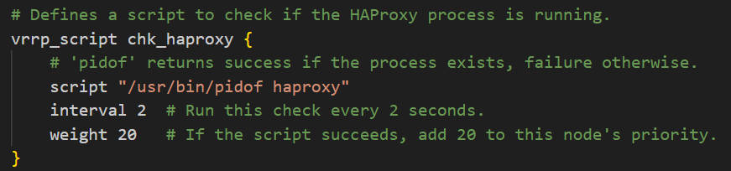
Health Check Mechanism Overview
Understanding vrrp_script and HAProxy process resilience
The health check mechanism utilizes vrrp_script to monitor the HAProxy process health. This system ensures automatic failover by switching the Virtual IP (VIP) between MASTER and BACKUP, maintaining service continuity during failures while balancing incoming traffic effectively.

Slide 8

Tier 2 & 3 Architecture
Load Balancing
Horizontal Scaling
Configuration Management
Distributing incoming traffic across multiple servers enhances performance and reliability.
Adding more web servers allows for increased capacity without downtime or disruptions.
Updating HAProxy configurations is straightforward, ensuring seamless integration of new servers.

Slide 9

haproxy.cfg Snippet Overview
Understanding the Roundrobin Balance Algorithm
The Roundrobin balance algorithm in HAProxy efficiently distributes incoming traffic across multiple backend servers. This method ensures that each server receives equal load, optimizing performance and preventing any single server from becoming overwhelmed during peak usage times.

Slide 10
Scaling your web servers efficiently
Horizontal scaling made simple
Adding new web servers such as web4 and web5 is straightforward, enhancing system performance and maintaining user experience during peak loads.
Updating HAProxy configuration
Modify the HAProxy configuration file to include the new servers, ensuring traffic is distributed evenly across all available resources.
Seamless system restart process
Restarting HAProxy applies the new configuration
Minimal disruption to user experience
Continuous operation throughout scaling process

Slide 11
Check normal operation by accessing web servers via HAProxy.
Simulate failover by stopping the master container in Docker.
Monitor Keepalived logs for VIP switches and health checks.
Verify response times and service availability during failover.
Document any discrepancies or issues for troubleshooting purposes.
Demo Instructions for System Verification
Follow these steps to verify system functionality and resilience:

Slide 12
System Capabilities of Our Resilient Architecture
Key features that enhance web system performance and management:
Resilience: Eliminates single points of failure using HAProxy and Keepalived.
Scalability: Easily add servers without impacting overall system performance.
Ease of Management: Docker simplifies deployment and configuration consistency across environments.
Load Balancing: Efficiently distributes traffic across multiple web servers for optimal performance.

Slide 13
Thank You & Questions
We appreciate your attention and welcome any questions regarding the presentation today.
Phone
+84-922-566-388
Email
dungtmhe186884@fpt.edu.vn

